Slide 1

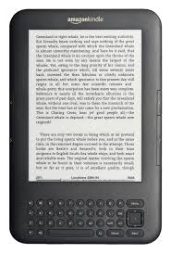
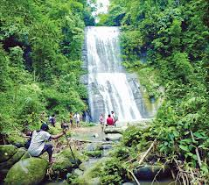
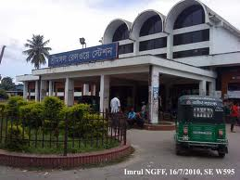
Welcome to
Srimangal

Slide 2

Nizam Uddin Jewel
Assistant teacher
Bahercor govt.primary school
Raipura, Narsingdi
Email:nizamuddinjewel@gmail.com
Skypee:nizamuddinjewel
Facebook:Nizam Uddin Jewel

Slide 3

Class:Five
Sub:English
Lesson:26, Page:91
Unit: B

Slide 4

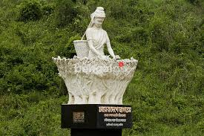
Students will be able to:
read the lesson with correct pronunciation and stress.
2)Know more about Scout jamboree and Srimangal.

Slide 5


Safe learning environment:
by watching video clip

Slide 6
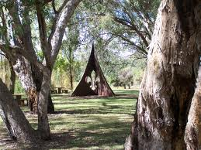
It Was a Great Day!

Slide 7
Teachers loud reading

Slide 8
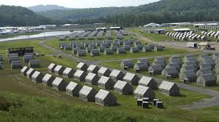
My name is Shuvo. I went to a scout jamboree last January.

Slide 9
The jamboree took place in Srimangal.

Slide 10
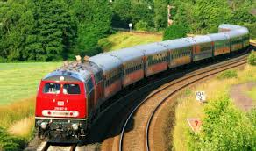
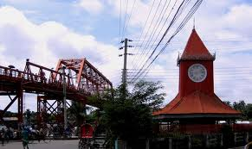

From Sylhet we came to srimangal by train.

Slide 11
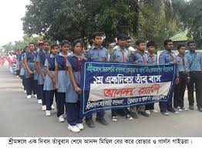
We started at 7 in the morning and arrived Srimangal at 8. Then we walked to our camp following scout signals.

Slide 12
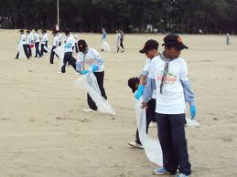
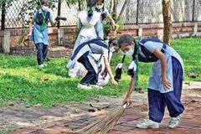
The first day started with cleaning.

Slide 13
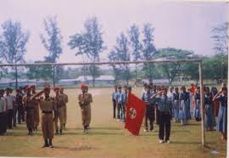
After breakfast, we took part in a march-past and display.

Slide 14
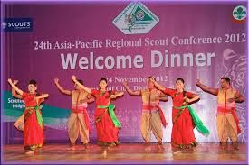
In the evening, we enjoyed a cultural programme.

Slide 15
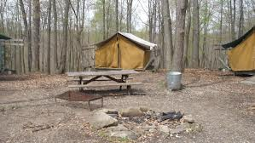
At night , we slept in the tent.

Slide 16
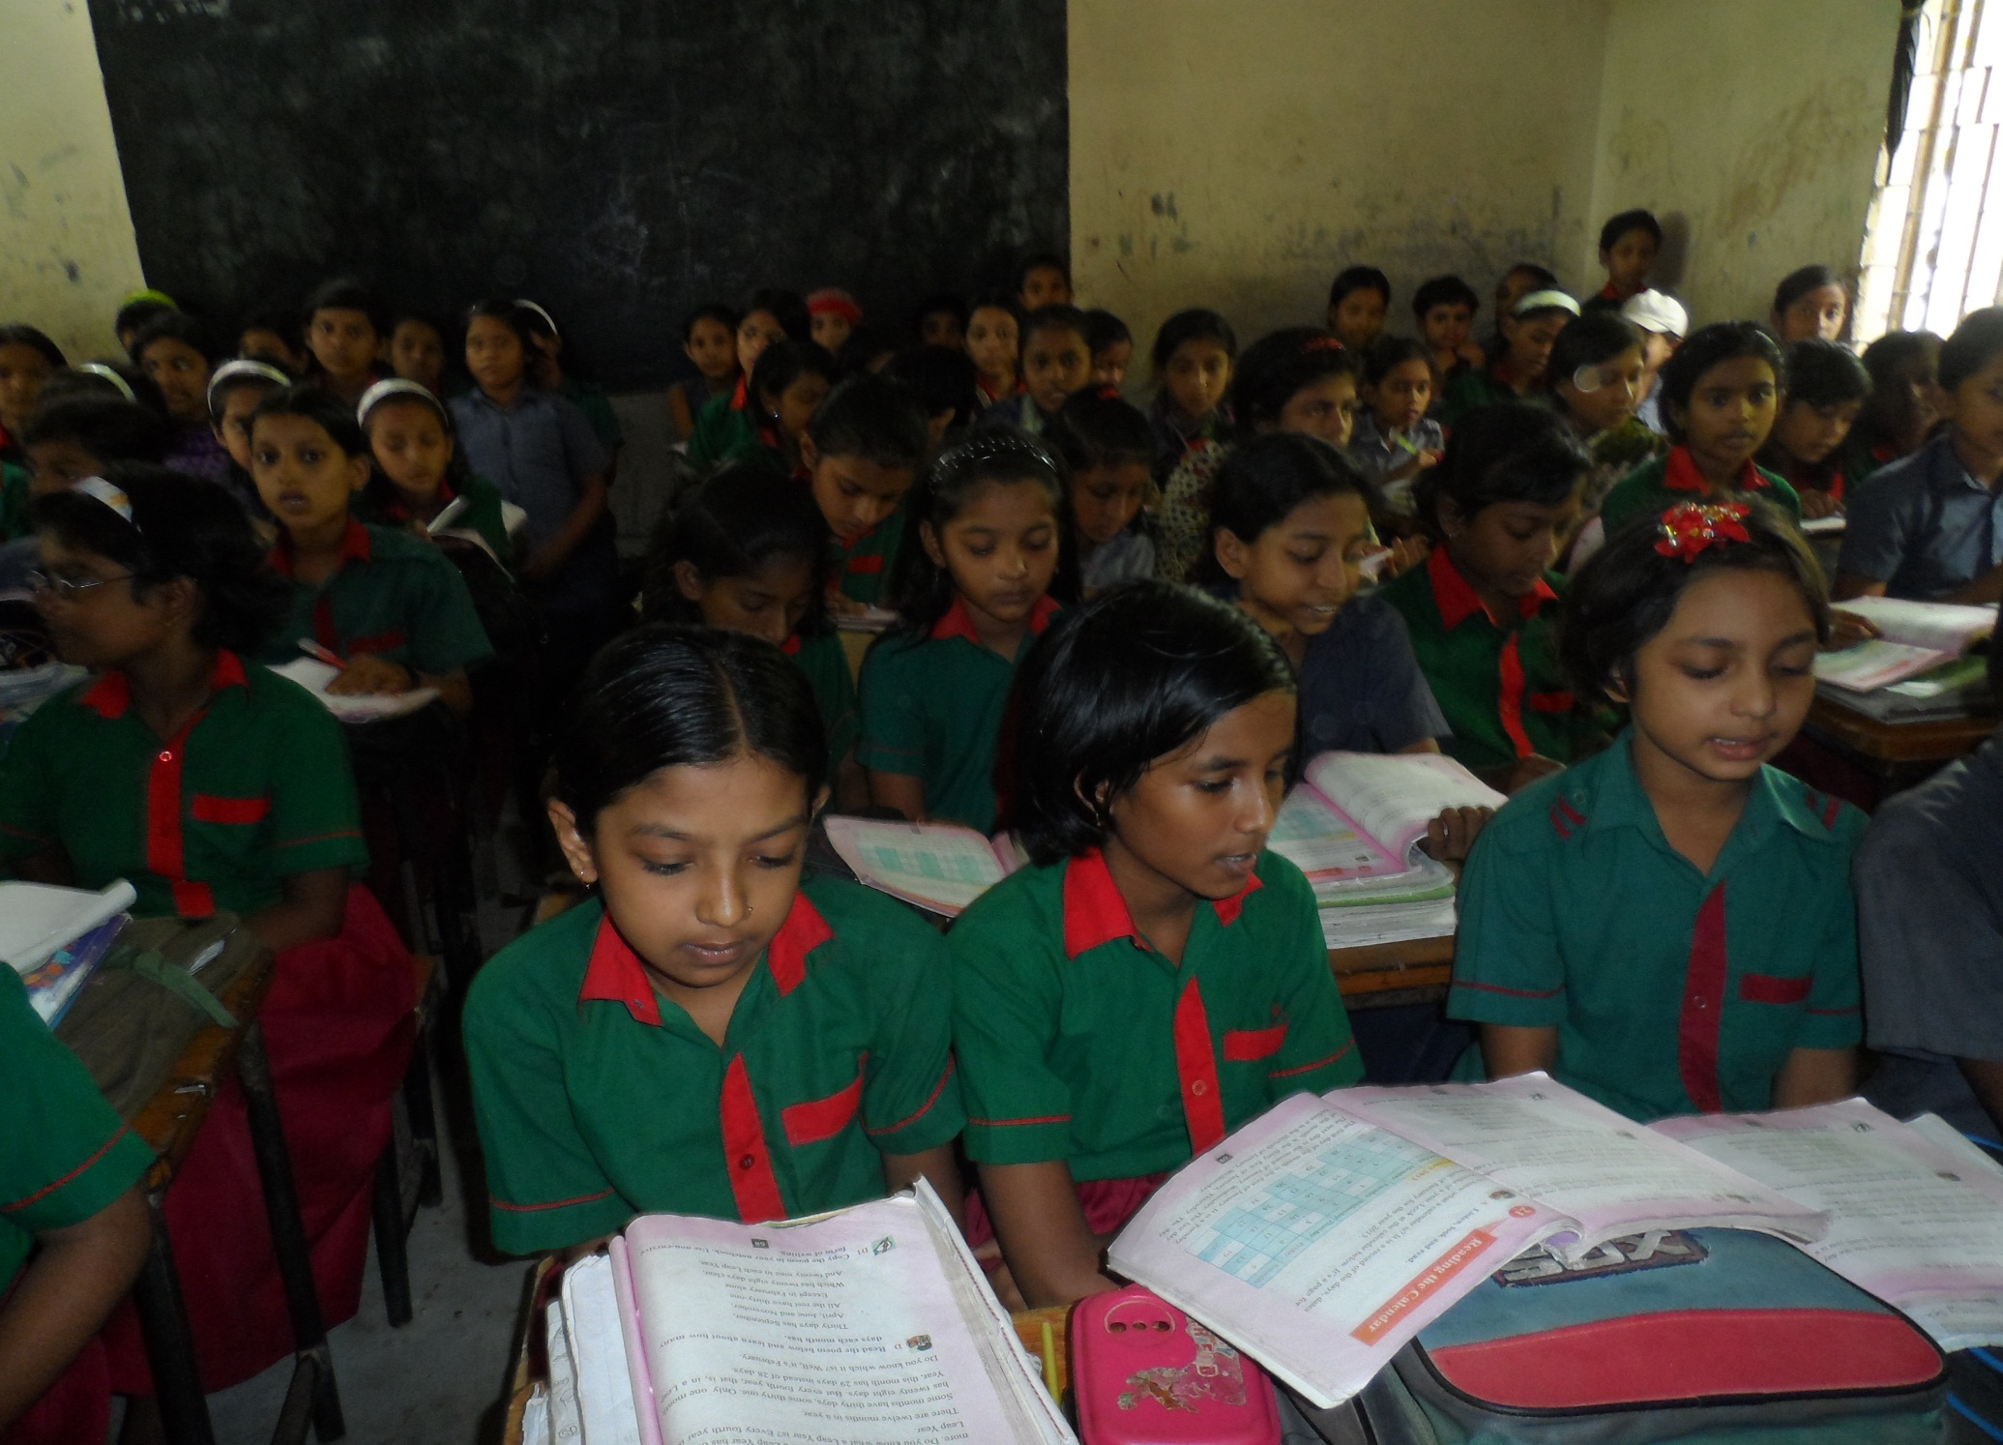
Silent reading

Slide 17
Multiple choice question :
1) The jamboree took place in ?
a) Lauachara b) Sylhet c) Srimangal d) Reserve Forest.
2) They came Srimangal by…..?
a) bus b) richshaw c) Train d) on foot.
3) When they started their journey?
a) At 8 b) at 7 in the night c) at7 in the mornig
4) When they arrived ?
a) at 8 in the night, b) 6 pm c) at 8 am. d) at 8 pm.
5) Where they slept at night ?
a) In Room b) In a open field c) In the tent d) In a town

Slide 18
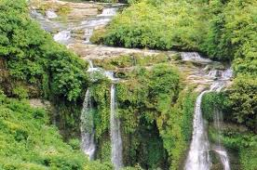
Fill in the gaps:
1) They didn’t take any…..
2) It was a………. For two days.
3) The first day started with……..
4) They had a……class from 2 to 4p.m.
5) They……..in the tent.

Slide 19
Answer the following question:
1) Who went to a scout Jamboree?
2) How did he come to Srimangal ?
3) How many members did the team have ?
4) How did the first day start with ?
5) What did Shuvo and his team enjoy in the evening ?

Slide 20
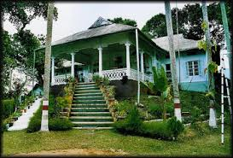
Home work.
Write a small paragraph about Your experience of a great day.

Slide 21
Thanks my dear students.
see you
next class.

